Slide 1
JQuery
2012. 10
Youn-Hee Han
LINK@KOREATECH
http://link.koreatech.ac.kr

Slide 2


jQuery is a lightweight, open-source
JavaScript library
that simplifies interaction
between HTML and JavaScript
It was and still being
developed
by John Resig from Mozilla and was first announced
in January 2006

Slide 3
What is jQuery?
jQuery is a library of JavaScript Functions.
  "write less, do more“
  Cross-browser support
  CSS-like syntax – easy for developers/non-developers to understand
  Active developer community
  Extensible - plugins
Features
  HTML element selections
  HTML element manipulation
  CSS manipulation
  HTML event functions
  JavaScript Effects and animations
  HTML DOM traversal and modification
  AJAX

Slide 4
Adding the jQuery Library to Your Pages
Getting Started
  직접 다운로드 받아 사용 (http://jquery.com)
  CDN Hosted jQuery
    Google
  항상 최신버전으로…
<head>
<script type="text/javascript" src="jquery-1.8.2.min.js"></script>
</head>
<head>
<script type="text/javascript" src="https://ajax.googleapis.com/ajax/libs/jquery/1.8.2/jquery.min.js">
</script>
</head>
<head>
<script src="http://code.jquery.com/jquery-latest.js"></script>
</script>
</head>

Slide 5
Adding the jQuery Library to Your Pages
Getting Started
  동작 확인을 위한 예제
<html>
<head>
<script type="text/javascript" src="https://ajax.googleapis.com/ajax/libs/jquery/1.8.2/jquery.min.js"></script>
<script type="text/javascript">
$(document).ready(function(){
$("button").click(function(){
$("p").toggle();
});
});
</script>
</head>
<body>
<h2>This is a heading</h2>
<p>This is a paragraph.</p>
<p>This is another paragraph.</p>
<button>Click me</button>
</body>
</html>
$(document).ready(function() {
…
});
$(function() {
…
});

Slide 6
jQuery Syntax
The jQuery syntax is tailor made for selecting HTML elements and perform some action on the element(s).
  Basic syntax is:
  jQuery(selector).action()
  or
  $(selector).action()
    “dollar sign” define jQuery
    “selector” → query Javascript object or find HTML elements
    jQuery action() → performed on the element(s)
    Ex. CSS class ‘notLong’를 가진 div element들을 숨기고 ‘removed’라는 CSS class를 추가
  JQeury Selector 및 함수 정리
    http://ggoreb.tistory.com/172
    http://api.jquery.com/category/selectors/
$("div.notLong").hide().addClass("removed");

Slide 7
jQuery Selectors
jQuery Element Selectors
  CSS 셀렉터와 거의 유사
  $("p") selects all <p> elements.
  $("p.intro") selects all <p> elements with class="intro"
  $("p#demo") selects all <p> elements with id="demo"
jQuery Attribute Selectors
  $("[name]") select all elements with a “name” attribute
  $("[name='#']") select all elements with a “name” value equal to "#“
  $("[name*='abc']") select all elements with a “name” value containing the given substring ‘abc’
  $("[name!='#']") select all elements with a “name” value NOT equal to "#"
  $("[name$='.jpg']") select all elements with a “name” value that ends with ".jpg“
  $("[name^=‘news']") select all elements with a “name” value beginning exactly with a given string ‘news’

Slide 8
jQuery Selectors
Example
<!DOCTYPE html>
<html>
<head>
<script src="http://code.jquery.com/jquery-latest.js"></script>
</head>
<body>
<input name="man-news" />
<input name="milkman" />
<input name="letterman2" />
<input name="newmilk" />
<script>$('input[name*="man"]').val('has man in it!');</script>
</body>
</html>
<!DOCTYPE html>
<html>
<head>
<script src="http://code.jquery.com/jquery-latest.js"></script>
</head>
<body>
<input name="newsletter" />
<input name="milkman" />
<input name="jobletter" />
<script>$('input[name$="letter"]').val('a letter');</script>
</body>
</html>
LINK@KOREATECH

Slide 9
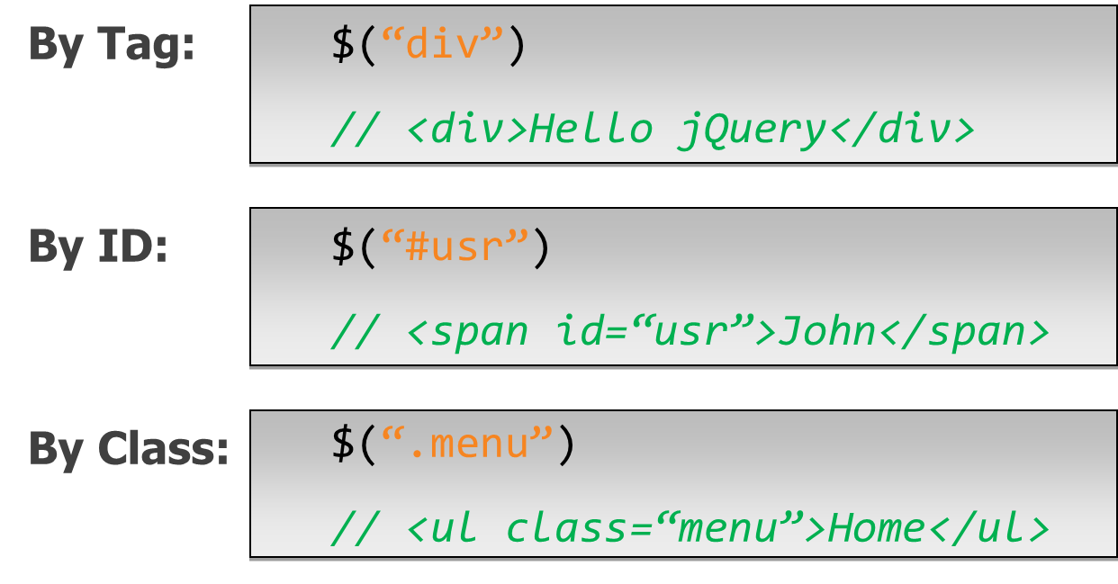
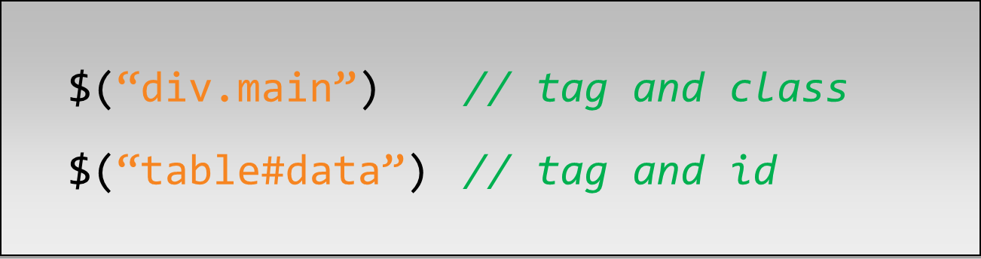
jQuery Selectors
Yes, jQuery implements CSS Selectors!
LINK@KOREATECH

Slide 10
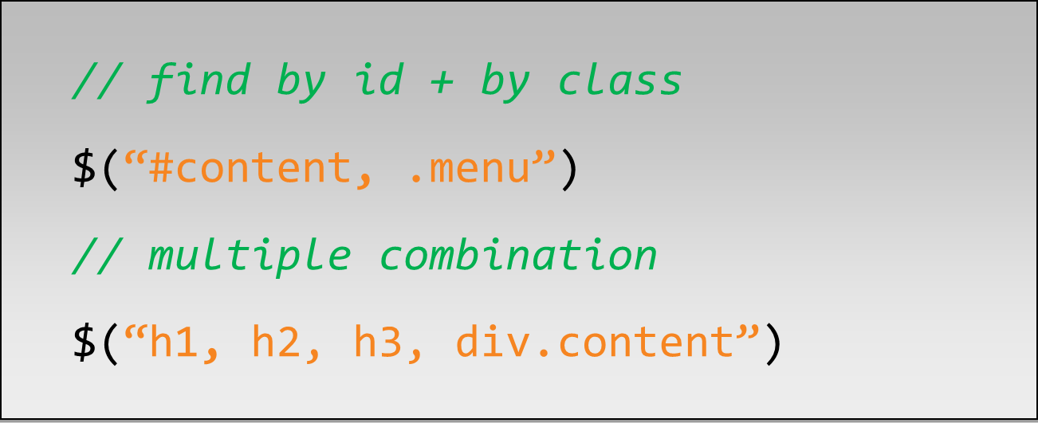
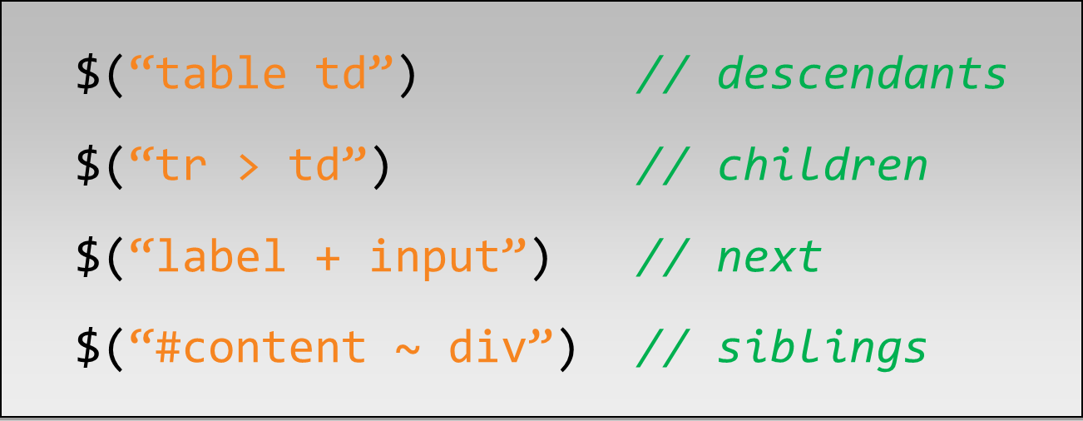
jQuery Selectors
Combination of Selectors
Hierarchy Selectors
label 엘리먼트와 동일한 레벨에 존재하는 형제 엘리먼트 input
#content를 ID로 지니는 엘리먼트와 동일한 레벨에 존재하는 모든 형제 엘리먼트 div
LINK@KOREATECH

Slide 11
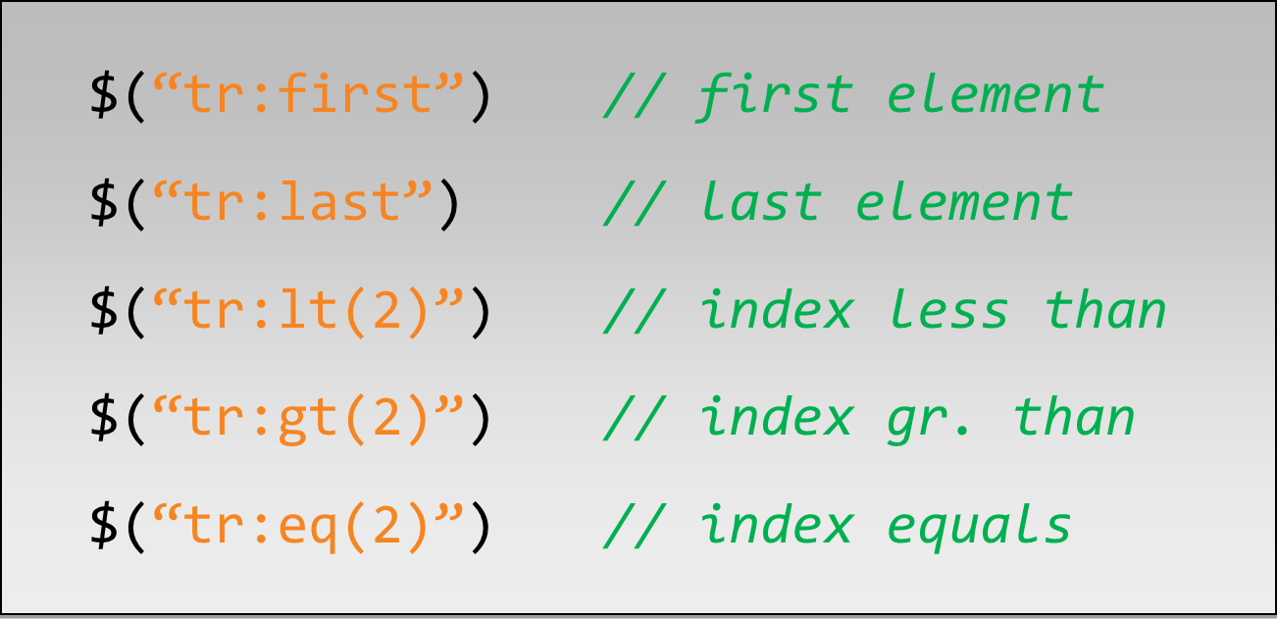
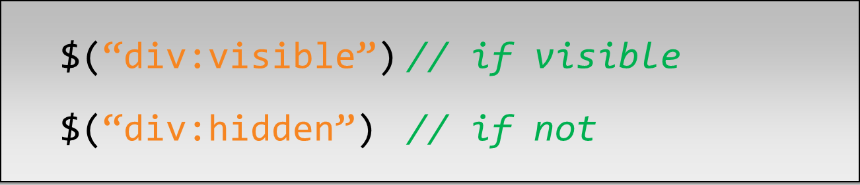
jQuery Selectors
Selection Index Filters
  :first-child
  :last-child
Visibility Filters
LINK@KOREATECH

Slide 12
jQuery Selectors
Example
<!DOCTYPE html>
<html>
<head>
<style>
span { color:#008; }
span.sogreen { color:green; font-weight: bolder; }
</style>
<script src="http://code.jquery.com/jquery-latest.js"></script>
</head>
<body>
<div>
<span>John,</span>
<span>Karl,</span>
<span>Brandon</span>
</div>
<div>
<span>Glen,</span>
<span>Tane,</span>
<span>Ralph</span>
</div>
<script>
$("div span:first-child")
.css("text-decoration", "underline")
.hover(function () {
$(this).addClass("sogreen");
}, function () {
$(this).removeClass("sogreen");
});
</script>
</body>
</html>
LINK@KOREATECH

Slide 13
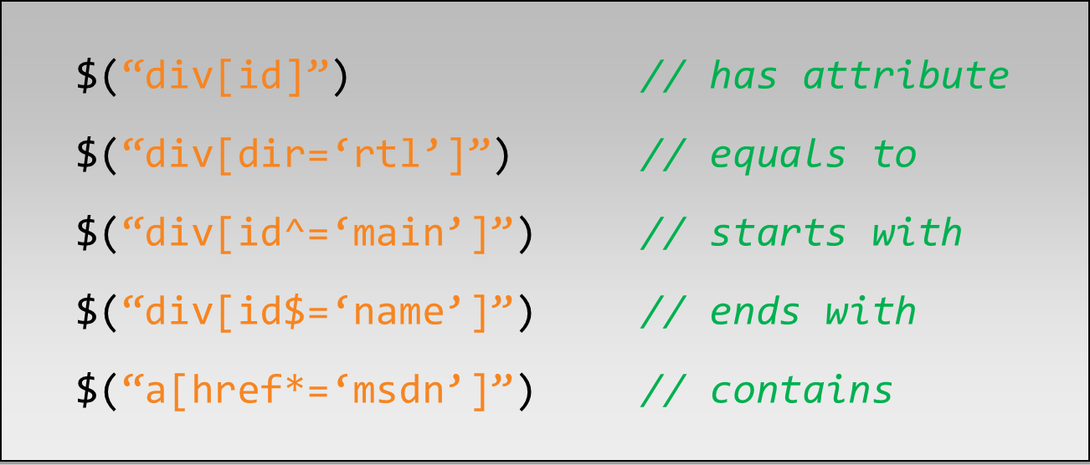
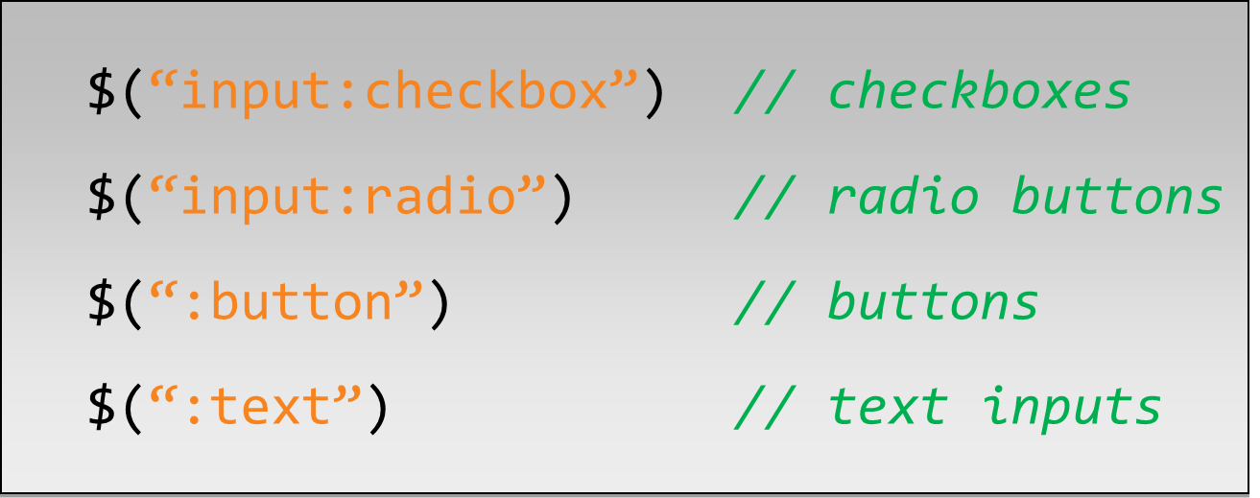
jQuery Selectors
Attribute Filters
Forms Selectors
LINK@KOREATECH

Slide 14
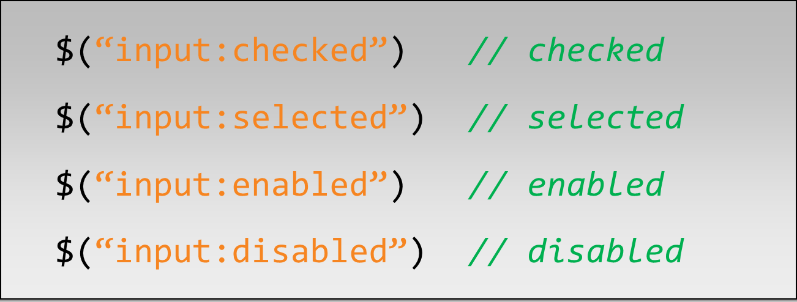
jQuery Selectors
Forms Filters
  Ex. Find Dropdown Selected Item
<select name="cities">
<option value="1">Tel-Aviv</option>
<option value="2" selected="selected">Yavne</option>
<option value="3">Raanana</option>
</select>
…
<script type="text/javascript">
document.write($("select[name='cities'] option:selected").val());
</script>
LINK@KOREATECH

Slide 15
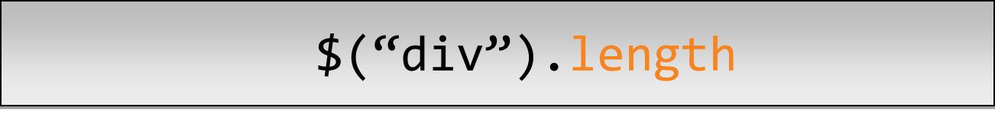


jQuery Selectors
A Selector returns a pseudo array of jQuery objects
  It returns number of selected elements.
Getting a specific DOM element
  They return a 2nd DOM element of the selection
LINK@KOREATECH

Slide 16
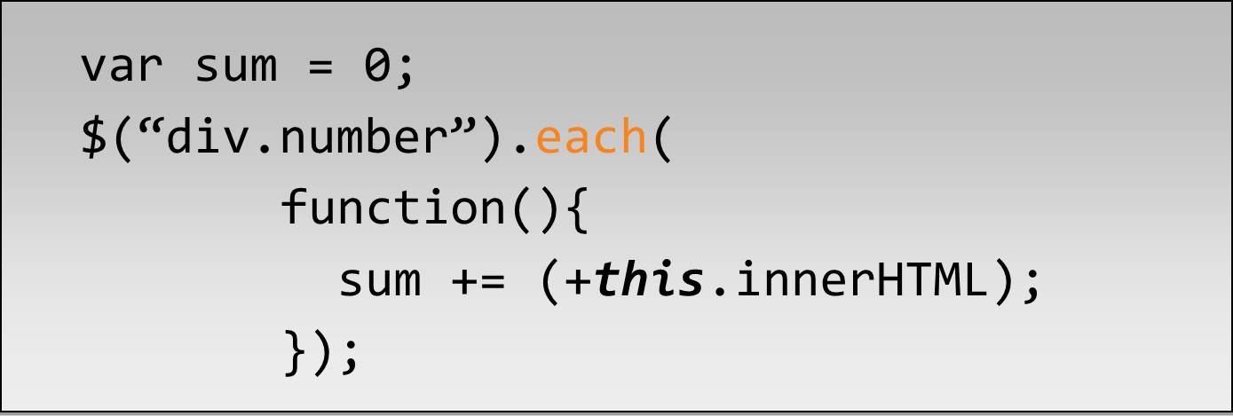
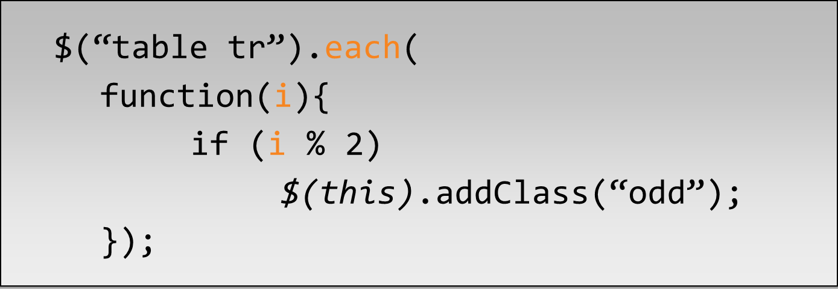
jQuery Selectors
“each(fn)” traverses every selected element calling fn()
  “this” – is a current DOM element
“each(fn)” also passes an indexer
  $(this) : convert the current DOM element to jQuery object
  i : index of the current element
LINK@KOREATECH

Slide 17
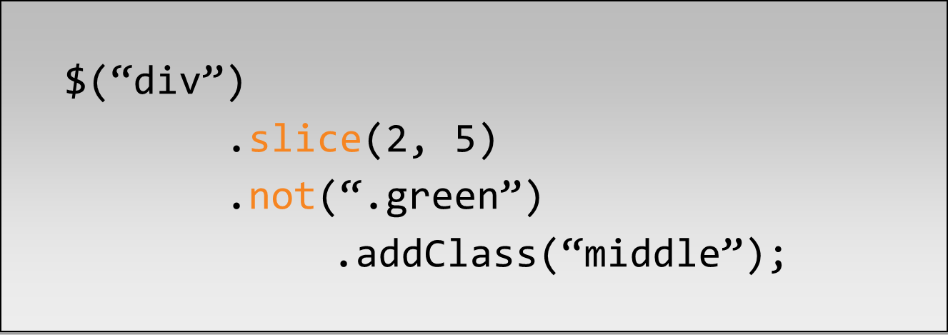
jQuery Selectors
Get Part of Selected Result
LINK@KOREATECH

Slide 18
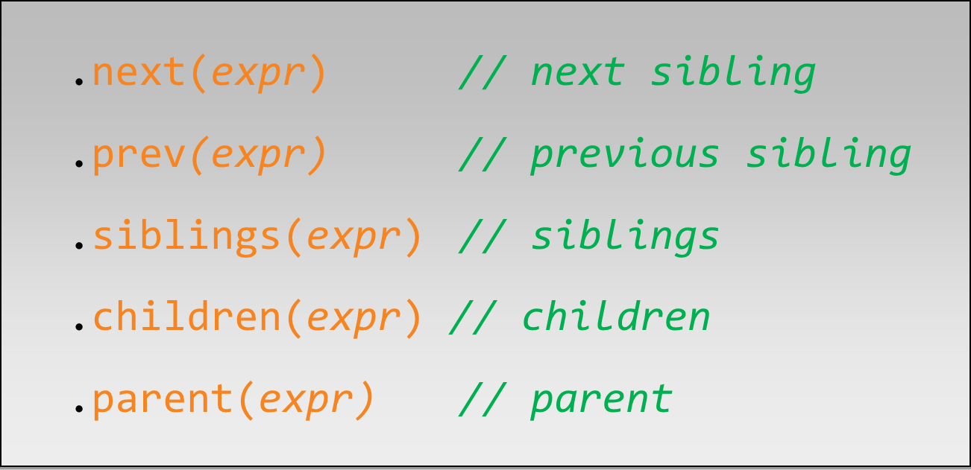
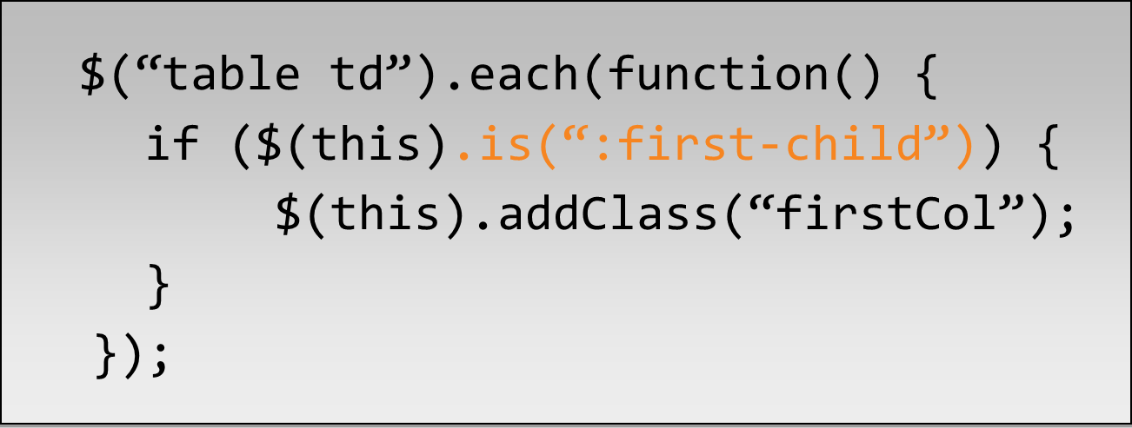
jQuery Selectors
Traversing DOM elements
Check for expression
LINK@KOREATECH

Slide 19
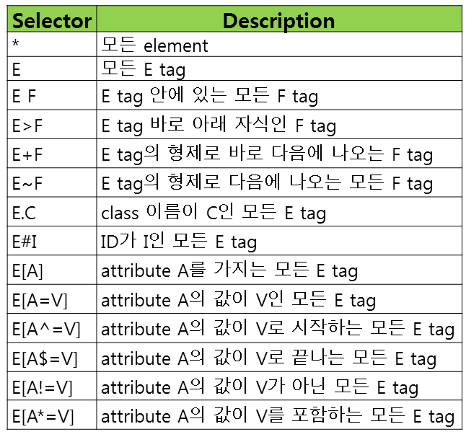
jQuery Selectors 총정리
jQuery가 지원하는 CSS selector
<E class=C id=A>
<E id=I>
<F id=C>
<E A=H id=B>
<E A=V id=D>
LINK@KOREATECH

Slide 20
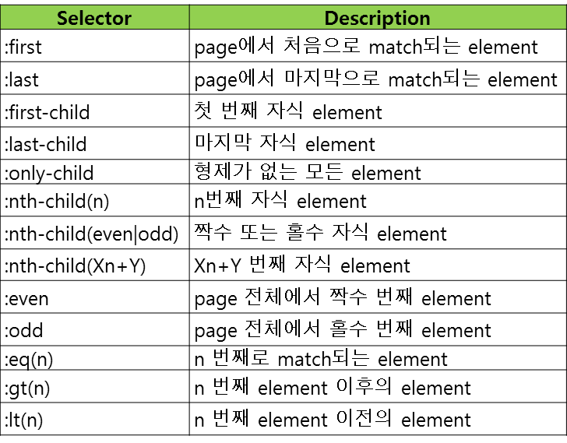
jQuery Selectors 총정리
jQuery가 지원하는 위치 기반 selector
LINK@KOREATECH

Slide 21
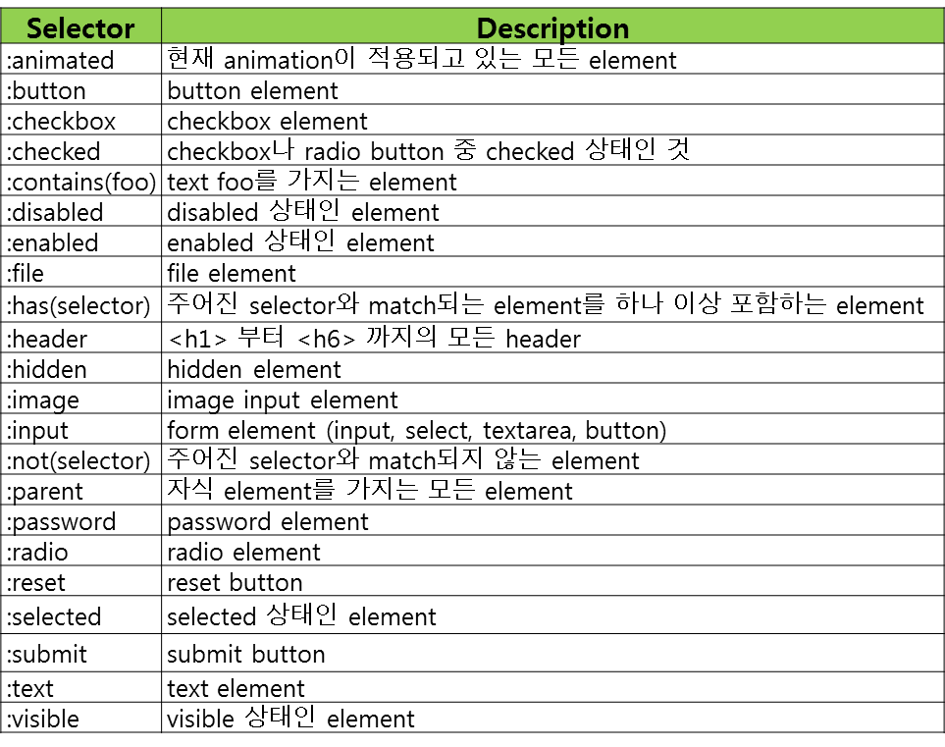
jQuery Selectors 총정리
jQuery 정의 filter selector
LINK@KOREATECH

Slide 22
jQuery Events
jQuery Event Function
  $("button").click(function() {..some code... } )
Examples
Event Method | Description
$(document).ready(function) | Binds a function to the ready event of a document (when the document is finished loading)
$(selector).click(function) | Triggers a function to the click event of selected elements
$(selector).dblclick(function) | Triggers a function to the double click event of selected elements
$(selector).focus(function) | Triggers a function to the focus event of selected elements
$(selector).mouseover(function) | Triggers a function to the mouseover event of selected elements
Notes:
Coined in 2002 (Macromedia)

Slide 23
jQuery Events
bind(eventType, handler)
  element에 지정한 eventType에 대한 handler를 설정
one(eventType, handler)
  element에 지정한 eventType에 대한 handler를 설정하되, 한 번 실행 후 삭제
unbind(eventType, handler), unbind(event)
  element에 설정된 handler를 선택적으로 제거
more events..
  http://api.jquery.com/category/events/
$('img').bind('click', function(){alert('Hi there!');});
$('#thing1').bind('click', someListener);
$('#thing2').bind('click', someOtherListener);
...
$('#thing2').unbind('click');
Notes:
Coined in 2002 (Macromedia)

Slide 24
jQuery Effects
jQuery Effects
  Hide, Show, Toggle, Slide, Fade, and Animate
more effects..
  http://www.w3schools.com/jquery/jquery_effects.asp
  http://api.jquery.com/category/effects/
Function | Description
$(selector).hide() | Hide selected elements
$(selector).show() | Show selected elements
$(selector).toggle() | Toggle (between hide and show) selected elements
$(selector).slideDown() | Slide-down (show) selected elements
$(selector).slideUp() | Slide-up (hide) selected elements
$(selector).slideToggle() | Toggle slide-up and slide-down of selected elements
$(selector).fadeIn() | Fade in selected elements
$(selector).fadeOut() | Fade out selected elements
$(selector).fadeToggle() | Toggle fade-in and fade-out of selected elements
Notes:
Coined in 2002 (Macromedia)

Slide 25
jQuery HTML Manipulation
Getting or Changing HTML Content
  $(selector).html()
    get the contents of matching HTML elements
  $(selector).html(content)
    The html() method changes the contents (innerHTML) of matching HTML elements
    ex) $("p").html("W3Schools");
  $(selector).text()
    get the text contents of matching HTML elements
  $(selector).text(content)
    This method escapes the string provided as necessary so that it will render correctly in HTML.
<div class="demo-container">
<div class="demo-box">Demonstration Box</div>
<ul>
<li>list item 1</li>
<li>list <strong>item</strong> 2</li>
</ul>
</div>
$('div.demo-container').text('<p>This is a test.</p>')
<div class="demo-container">
&lt;p&gt;This is a test.&lt;/p&gt;
</div>
Notes:
Coined in 2002 (Macromedia)

Slide 26
jQuery HTML Manipulation
Adding HTML content
  $(selector).append(content)
    The append() method appends content to the inside of matching HTML elements.
  $(selector).prepend(content)
    The prepend() method "prepends" content to the inside of matching HTML elements.
  $(selector).insertAfter(content)
more HTML manipulation..
  http://api.jquery.com/category/manipulation/
$("p").insertAfter(“div");
Notes:
Coined in 2002 (Macromedia)

Slide 27
jQuery CSS Manipulation
jQuery css() Method
  css(name) - Return CSS property value
    $(this).css("background-color"); → this로 선택된 개체의 bgcolor값
  css(name,value) - Set CSS property and value
    $("p").css("background-color", "yellow"); → 모든 p의 bgcolor를 yellow로 변경
  css({properties}) - Set multiple CSS properties and values
    $("p").css({"background-color": "yellow", "font-size": "200%"});
Size manipulation
  height()
    $("#div1").height("200px");
  width()
    $("#div2").width("300px");
more CSS manipulation…
  http://api.jquery.com/css/
Notes:
Coined in 2002 (Macromedia)

Slide 28
Immediately-Invoked Func­tion
self-invoking anonymous function
  It passes “window.jQuery” into that function as argument
  It makes $ an alias to window.jQuery (original jQuery Object)
  It ensures that the $ will always refer to the jQuery object inside that function, no matter if other library has taken $ as other thing.
  Don’t make browsers complain by throwing an warning (or error)
(function ($) {
})(window.jQuery)
!(function ($) {
})(window.jQuery)
or
;(function ($) {
})(window.jQuery)
Notes:
Coined in 2002 (Macromedia)

